Slide 1
I-Focus
Group 10-11 Samuel Leong 4S1(17)
Ryan Tan 4S1(20)
Walter Kong 4O3(33)
Songyuan 4S2()
Notes:
[ REQUIRES SANSATION AND MUSEO FONT ]
Good morning judges and fellow students. I am Samuel, this is …
And today I am very pleased to present to you our Cat 10 project… I-Focus.
I-Focus is a project that could possibly change the way we interact with our devices.

Slide 2
Introduction

Slide 3
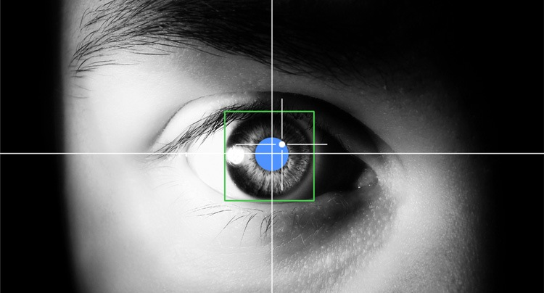
EFFICIENT.
Productive.
INTUITIVE.
Notes:
We are embarking on I-Focus - an EYE-tracking project that aims to use the latest eye-tracking technology and hopefully multi-modal input such as head gestures, in order bring you an efficient, productive and intuitive interface.

Slide 4


Objectives
Notes:
I-Focus aims to explore, through research with the Defence Science Organisation of Singapore, the most suitable input modes and their accompanying gestures.
This research, of course, will go hand in hand with applications and we will be creating a website along with a host games.. to not only demonstrate the areas in which eye-tracking can be utilised effectively, but also to be used as a tool to prove that our combination of gestures and input modes can be used by people for efficient, effective and intuitive interface control.

Slide 5

Target Audience
Physically Disabled
General Public
Notes:
And so… our project is aimed particularly at the physically disabled, as they would find our project the most useful. We can already imagine their joy as they utilise our intuitive, hands-free approach for interface manipulation. However, our project is likewise perfect for able-bodied individuals like you and I because our project is focuses on developing an intuitive interface that combines a host of input technologies

Slide 6

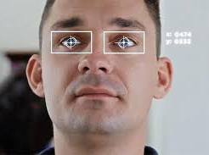
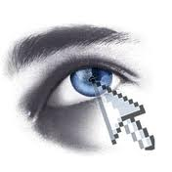
Why I-Focus?
Notes:
So this leads us to answer the question – why I-Focus? Why do we need a revamp in the current forms of mouse and even touchscreen inputs for able-bodied people?
…
3 words: efficiency, effectiveness and intuitiveness
The one-size-fits-all model of kinesthetic input which we get from the mouse is simply inefficient and unintuitive. We use the mouse for everything – clicking, moving, dragging.. And the only reason why we find the mouse pretty effective and efficient is because we have been using it for a long time. But let me explain how eye-tracking is superior to mouse navigation in terms of efficiency and convenience. I ask you to move your mouse from one corner of the screen to the other. Not so bad but not so fast either. Yet if I exaggerate it further and i ask you to move your mouse from one corner of a screen the size of the projector screen to the other… It becomes painstaking. With eye-tracking, everything is fast, efficient and convenient. Just look at where you want to move and click. Look at a link, click on it. Look at an icon, open the application. Efficient. Effective. Intuitive.

Slide 7
Final Products

Slide 8

The Device
EyeTribe Eye-tracker
Affordable
Accurate
Notes:
(bring to show)

Slide 9
Interface Control
Eye-tracking technologies
Multi-modal Input
Efficient.
Effective.
Intuitive.

Slide 10
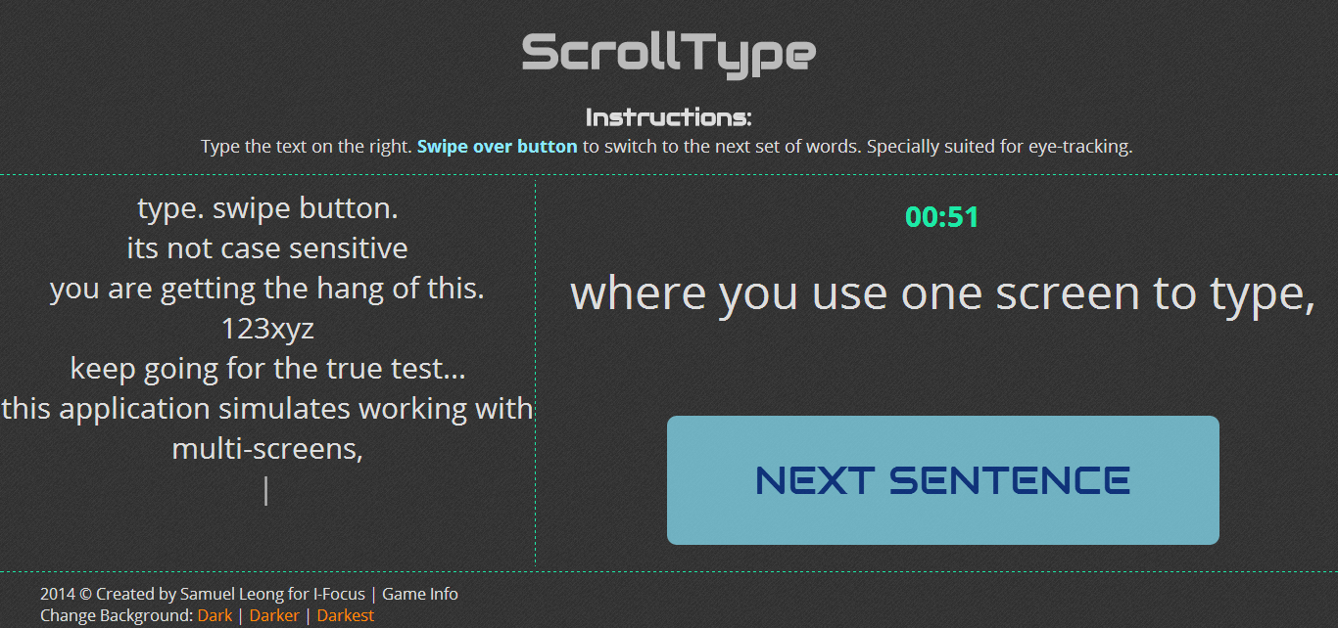
The Applications
Games
Website
Windows Application

Slide 11



Programming Languages
HTML 5
CSS 3
JavaScript
#

Slide 12
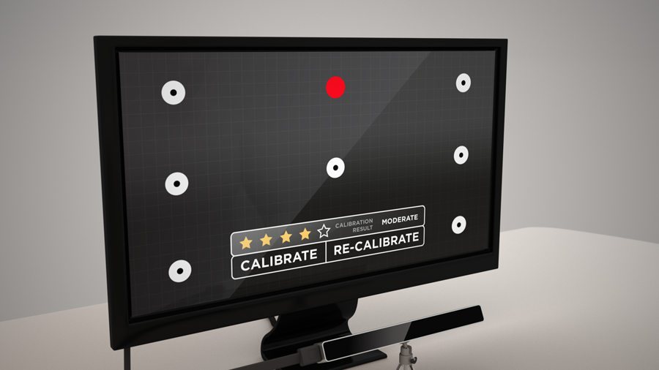
Sneek Peek
Notes:
Replace image with our own screenshot

Slide 13
Sneek Peek

Slide 14
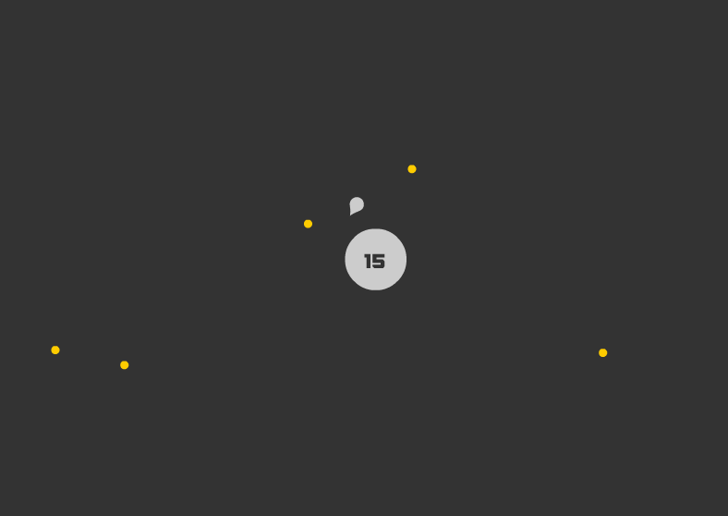
Sneek Peek

Slide 15
Originality

Slide 16
Survey
Notes:
Many p

Slide 17
Methodology

Slide 18
Methodology

Slide 19
Partners
Defence Science Organisation of Singapore
External Mentors
Research

Slide 20
Timeline

Slide 21
Job Distribution
Samuel
Walter
Ryan
Songyuan
Programming
Design
Logo
Website
Art
Research
Admin
Game Design
Console App
Website
Console App

Slide 22
Conclusion

Slide 23
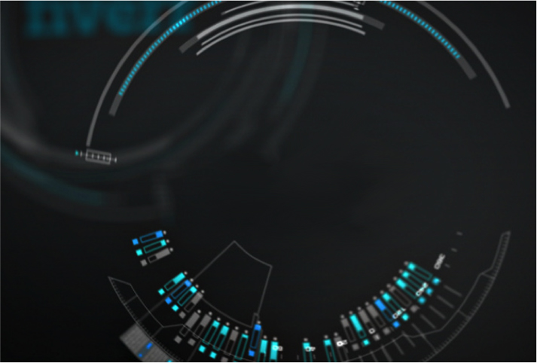
Thank You!

